Slide 1
Scripting for Data Analysis
Final Project
Jake Dineen & Mason David

Slide 2
Introduction
With the rising popularity in the significance of statistical analysis and machine learning for baseball related metrics, e.g. the Moneyball Oakland Athletics, increased shifting, and an emphasis on-base percentage, we wanted to take a look at baseball stats and use various methods to extract insight into what drives Hall of Fame candidacy.

Slide 3
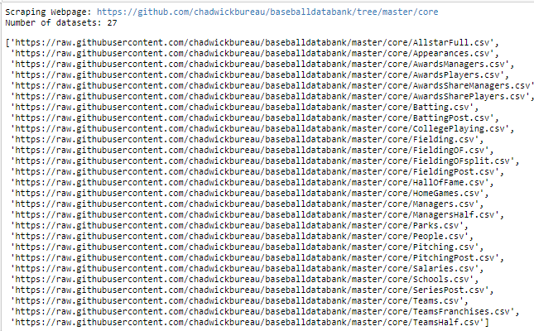
The Data
This project will center around collections of baseball data ranging from 1871 - 2014, essentially encompassing all recorded statistics over the course of the history of Major League Baseball.
Sean Lahman and a group of researchers are responsible for the collection and storage of most of the main files we will be working with, although there have been some crowdsourcing attempts at expanding the original sets to include such things as college statistics, and various player metadata.
We scrape the links, to the left, from a github repo. All data is not used do to time constraints.

Slide 4
Flow of our Program
Scrape csv URLs from git & Read applicable data into pandas dataframes.
Merging viable dataframes on playerid.
Cleaning data to reduce dimensionality and high density ‘null’ features.
Some basic time series analysis (This wasn’t our main focus here)
Master function for information retrieval on batting/pitching records. Uses pandas to slice/filter copy of original df based on user entered arguments. Example on jupyter notebook: iterate through a list of keystatistics and run each index of the list through the function to output the top 5 players in each statistic, in descending order, all time. This can be toggled per category, statistic, sliced by individual year (defaults to alltime records), and has an option for how many players you want to output.
Modeling – Extract hall of fame data and merge with respective dfs. Filter out all non-players. One hot encode target var.
Down sample majority class to enforce uniform distribution. 99% of players don’t make the HOF.
Create train test splits
Grid search for best parameters (GradientBoosted Classifer)
Error analysis (Classification Report and Confusion matrix)
Saved model with pickle.
Create master function that takes user input on a player name and fuzzy matches against our ‘player_name’ column. Feed that players’ statistics into our scoring algorithm (we use pickle to load the model here) and output probability that a player will make the hall (equivalent to a sigmoid activation).

Slide 5
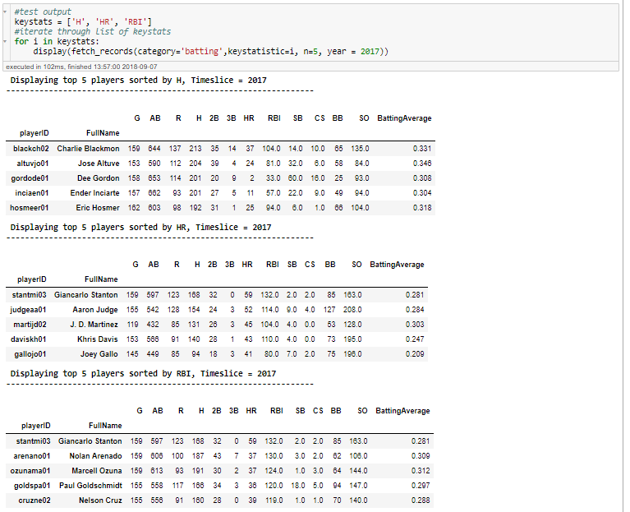
Sample Output of Information Retrieval (Batting)
The function being iterated through, to the right, takes the following arguments:
Category: ‘Batting’ or ‘Pitching’
Keystatistic: This is the stat that the table is being sorted on.
N: The count of required responses.
Year: integer between 1871 & 2017.
Defaults to show all time records.
Exception handling in place for some inputs that exceed min/max values.

Slide 6
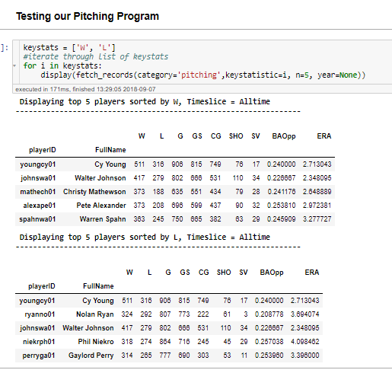
Sample Output of Information Retrieval (Pitching)
The function being iterated through, to the right, takes the following arguments:
Category: ‘Batting’ or ‘Pitching’
Keystatistic: This is the stat that the table is being sorted on.
N: The count of required responses.
Year: integer between 1871 & 2017.
Defaults to show all time records.
Exception handling in place for some inputs that exceed min/max values.

Slide 7
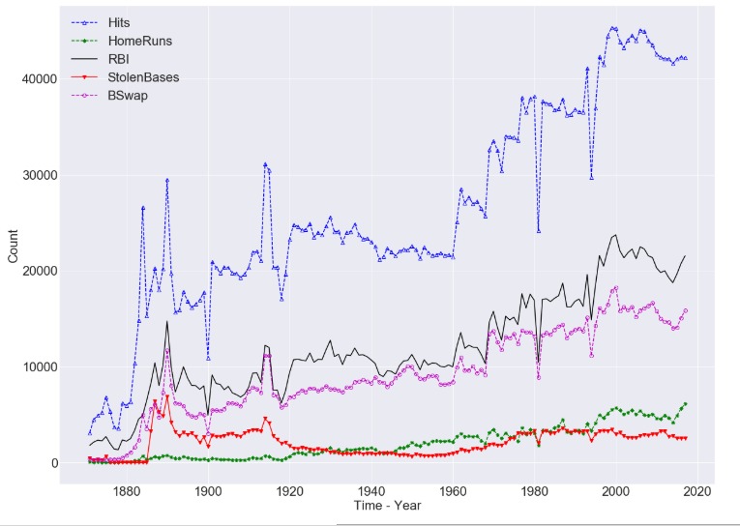
Showing how some statistics have changed over time.

Slide 8
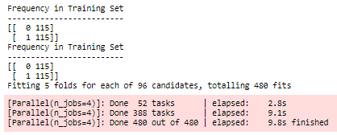
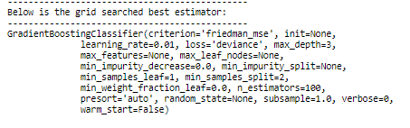

Building a Model
We instantiate our model.
Create a dictionary of possible parameters.
Grid search through those parameters to find our best estimator.
Evaluate our performance (accuracy) on our test set.
We had some issues constructing a model that contained both position player and pitching statistics – For a pitcher, the hitting statistics are mostly low or none, and vice versa. This may have ultimately impacted some of our feature ranking (There’s a bias towards position players due to a larger greater distribution of players belonging to that sub-category.

Slide 9
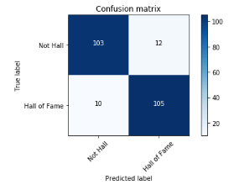
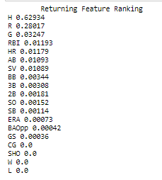
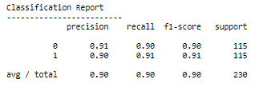
Building a Model
Here, we evaluate our model’s performance.
Accuracy was > 90% on our test set. This is good because we enforced that class balance at the start.
There’s no pattern to the types of errors that are being made. F1-score is similar on both classes.
Gradient Boosted Classifers have method called feature ranking, which we assumed was similar to relative entropy/information gain on decision trees, and that appears to be the case.
Feature importance is a way to show which attributes were used more frequently in making important decisions in each ‘learner’ of the ensemble.

Slide 10
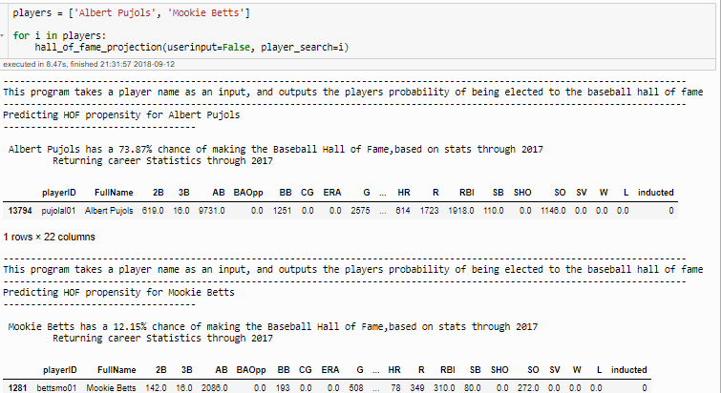
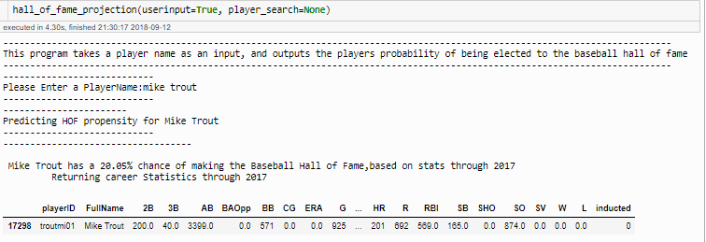
Wrapping that model into function
User Input
Iterating through a list of Players

Slide 11
Conclusion
This project consisted of extensive work in the domain of functional programming, as opposed to statistical analysis. While we touch on some descriptive stats and visualizations throughout our script, our main goal was to create a source where we could easily fetch baseball statistics, and if we wanted we could score a player and see what chances they have of making the hall of fame.
We ran into a number of issues working with data from so many different sources - Mainly duplicate entries per ID in one dataset that would mess with the calculations of a pandas group by function.
We used groupbys extensively because we wanted to be able to represent our data at a higher grain than the player level at most points in our script. When we reached the modelling point of our assignment, we had to figure out how to work with a problem that had severe class imbalance, ultimately deciding on downsampling our majority class to enforce uniform distributions. We also take a look at the GBclassifier Feature Ranking, showing us something similar to coefficients in a linear/logit model:

